Slide 1
Isoclock 2.0.1

Slide 2
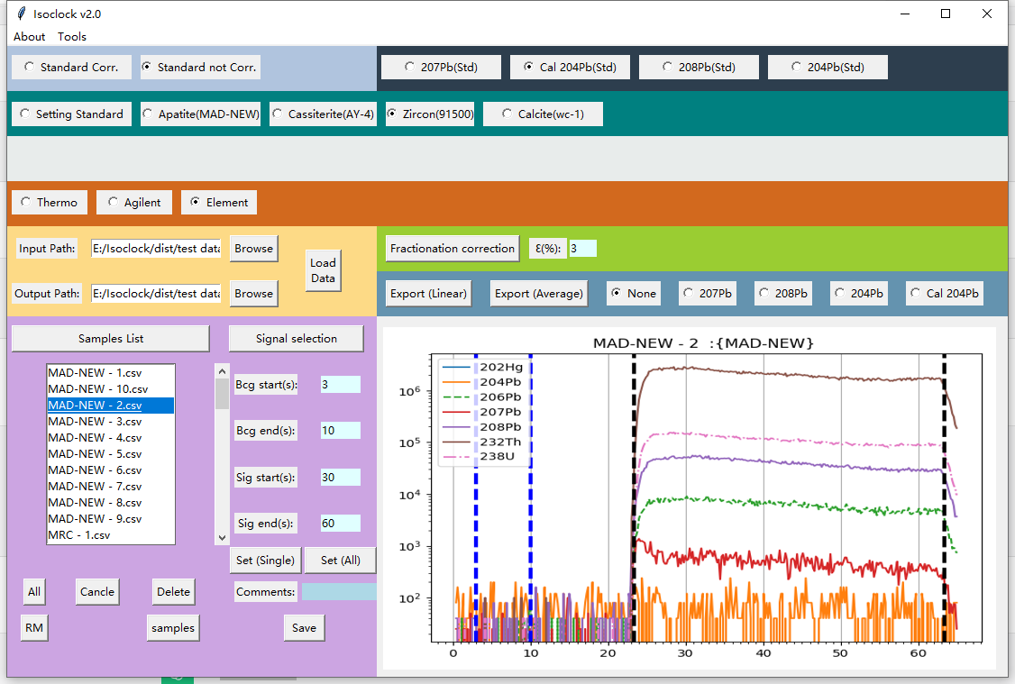
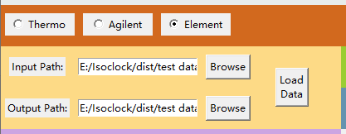
1. Import Data

Slide 3
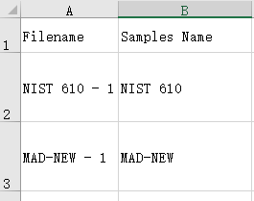
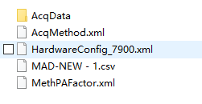
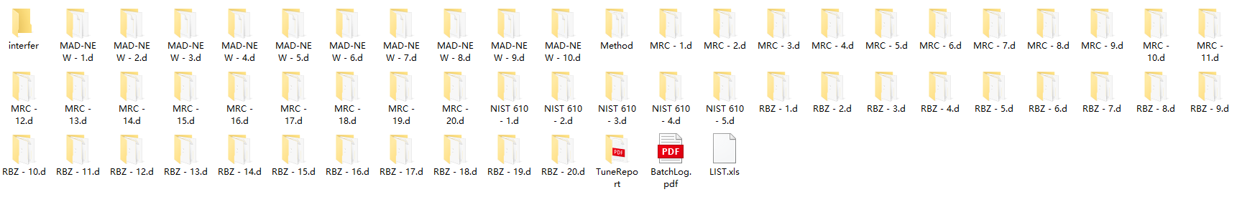
1.1 Data format(Agilent)
Filename: “MAD-NEW-1”
Samples Name: “MAD-NEW”
Ms filename: “MAD-NEW-1.csv”
folder : “MAD-NEW-1.d”
3. LIST FILE: “list.xls”

Slide 4
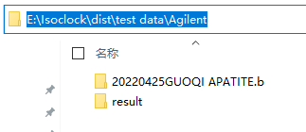
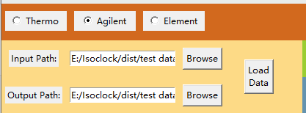
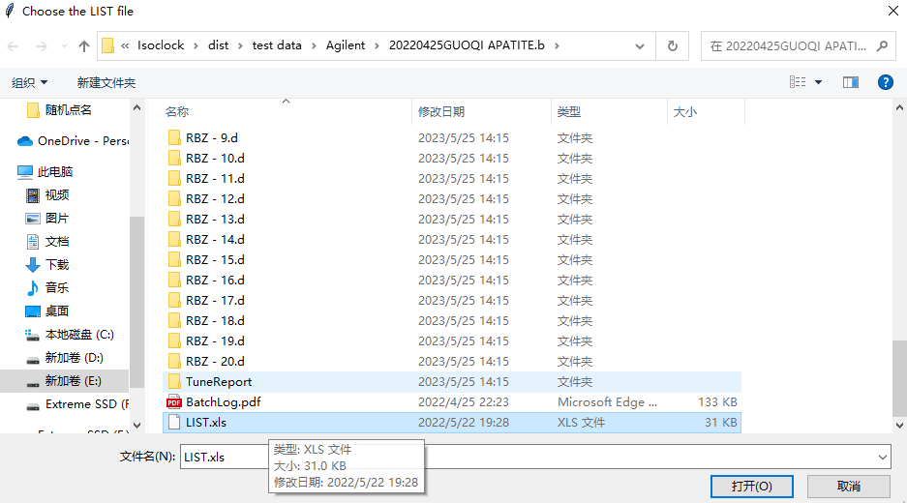
1.2 Load Data(Agilent)
Input path
output path
3. LIST FILE: “list.xls”

Slide 5
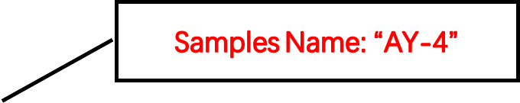
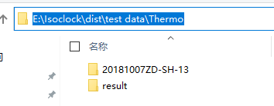
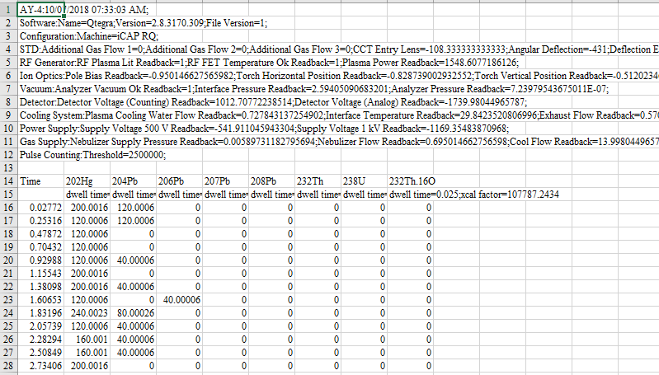
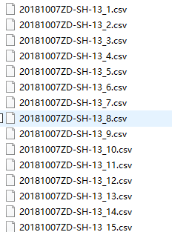
1.3 Data format(Thermo)
Input path
output path
Filename: “20181007ZD-SH-13_2”

Slide 6
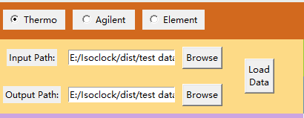
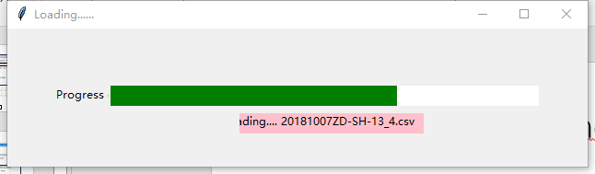
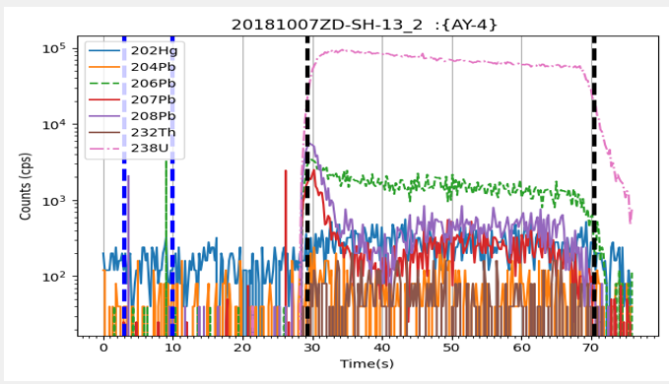
1.4 Load Data (Thermo)
Filename: “20181007ZD-SH-13_2”
Samples Name: “AY-4”

Slide 7
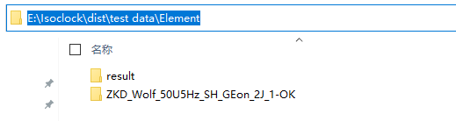
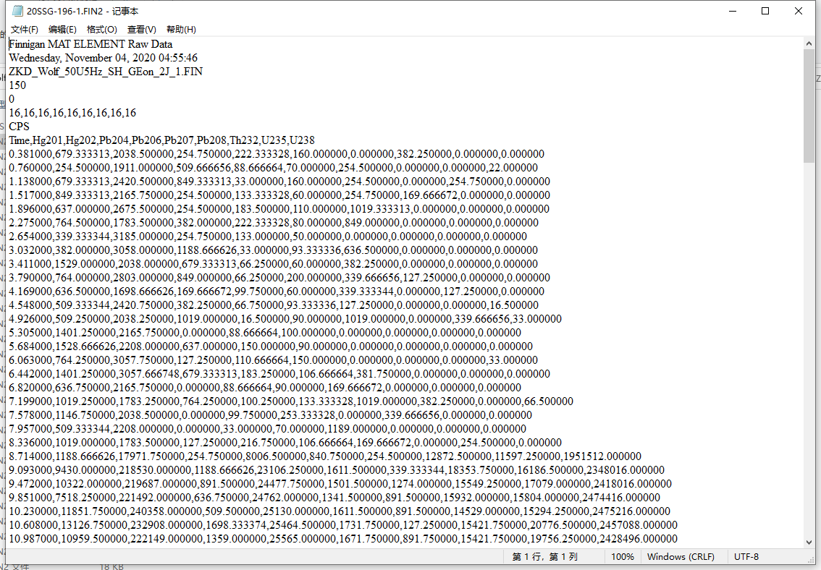
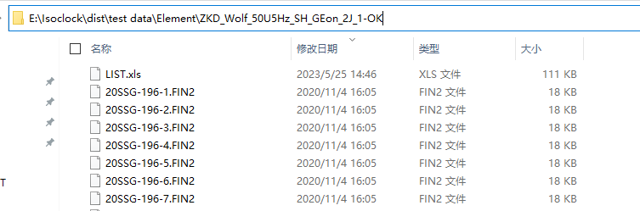
1.5 Data format (Element)
Element
Input path
output path
3. LIST FILE: “list.xls”

Slide 8
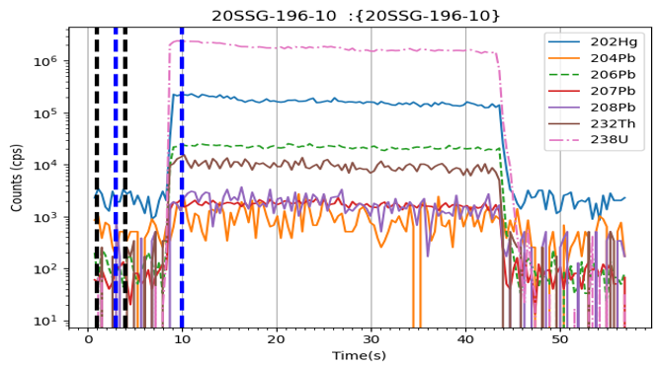
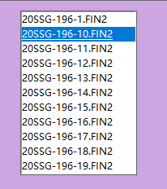
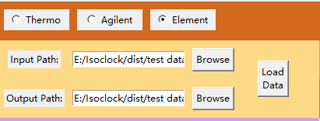
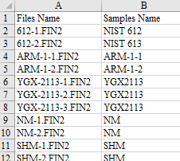
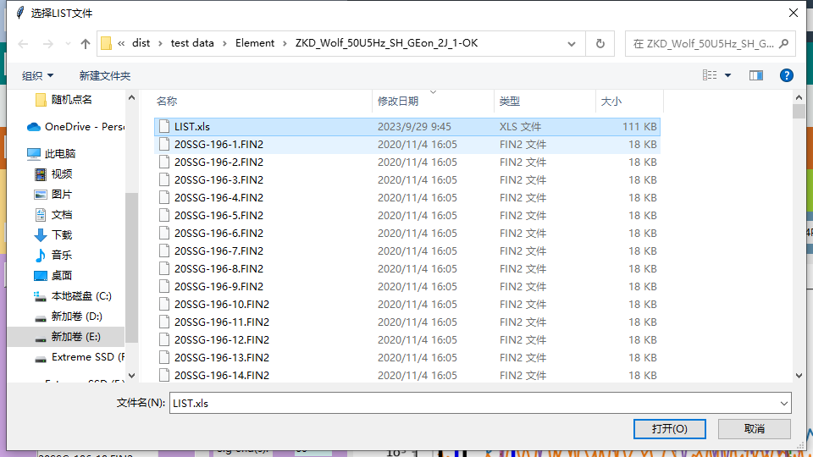
1.6 Load Data (Element)
3. LIST FILE: “list.xls”

Slide 9
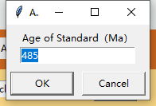
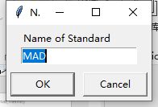
2. Standard setings

Slide 10


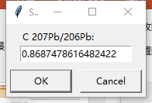
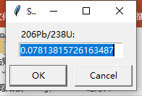
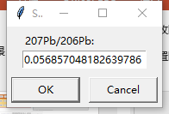
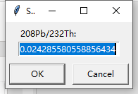
2.1 Is standard lead correction performed?
YES
No

Slide 11
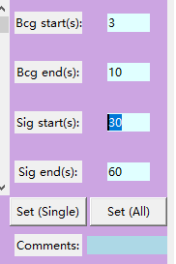
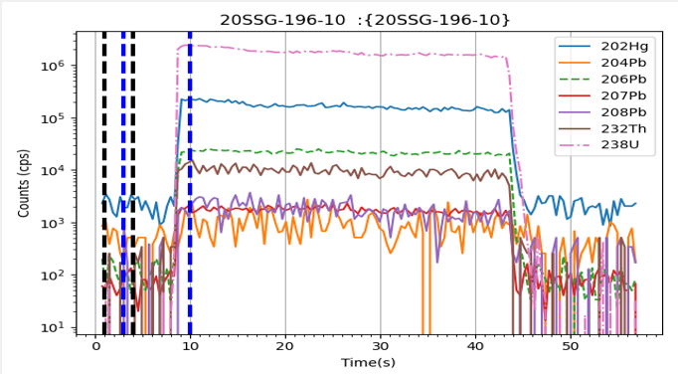
3. Integration Time Setting

Slide 12
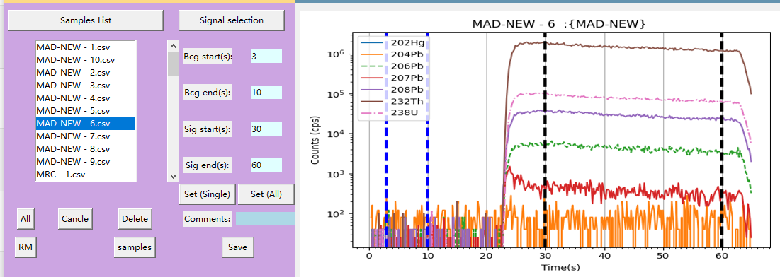
3.1 Set Uniform Parameters for All Samples and Standards

Slide 13
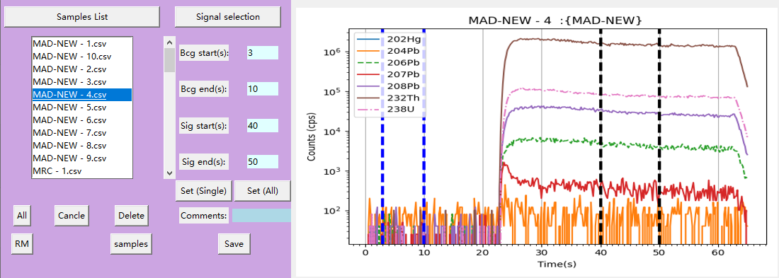
3.2 Individually Adjust Integration Time for Samples or Standards

Slide 14
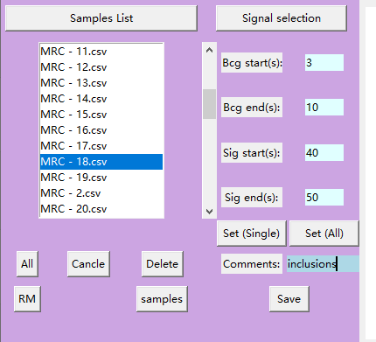
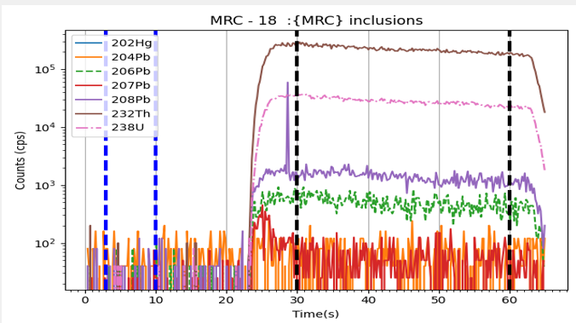
3.2 Individually Adjust Integration Time for Samples or Standards

Slide 15

4. Fractionation correction

Slide 16


4.1 Fractionation correction
When click “Fractionation correction”,Save the following files in the output folder:
Output path

Slide 17

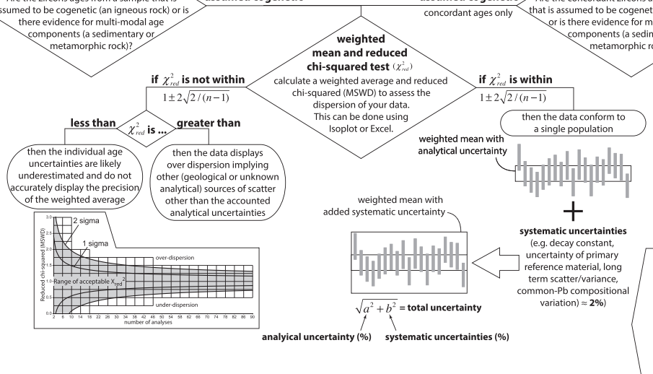
4.2 Configure the System Error to be Propagated
The uncertainty propagation method is referenced from Horstwood et al. (2016).

Slide 18
5. Export Calculation Results

Slide 19
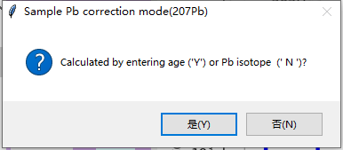
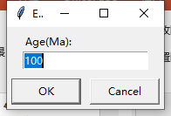
5.1 Is common Pb correction applied to the sample?
No
Yes

Slide 20

5.2 Export Results
Standard-sample bracketing Method
Average Method
Do not export the primary standard
Exprot the primary standard

Slide 21
References
Vido DEMO:
https://www.researchgate.net/publication/371039144_Demo_of_Isoclock20
Python code:
https://github.com/sndjgm/Isoclock
Reference: G. Liu, K. Zhao, T.Ulrich, W. Chen, D. Zhang, Q. Li, H. Zhao, R. Zhang and F. Xia, J. Anal. At. Spectrom., 2023
DOI https://doi.org/10.1039/D3JA00217A
EXE pakage:
https://1drv.ms/u/s!AjpkANeM2uTjmWLLxbmXgNLlvVQx?e=Wv1caz

